Slide 1
SAVE
LAB FOR SYSTEMS ANALYSIS AND VERIFICATION BLOG
A Survey of Software Fault Localization
Trinh Van Giang
HCMC University of Technology
August 06, 2014
A Survey of Software Fault Localization Trinh Van Giang

Slide 2
Outline
Introduction
Execution Dice-based Fault Localization
Suspiciousness Ranking-based Fault Localization
  Program Spectrum-based Fault Localization
  Slicing Spectrum-based Fault Localization
  Similarity Coefficient-based Fault Localization
  Mutation-based Fault Localization
Important Issues and Research Areas
Conclusions
A survey of Software Fault Localization Trinh Van Giang

Slide 3

  Introduction

Slide 4

Motivation
Testing and debugging activities constitute one of the most expensive aspects of software development
  Often more than 50% of the cost [Hailpern & Santhanam, 2003]
Manual debugging is…
  Tedious
  Time Consuming
  Error prone
  Prohibitively expensive
B. Hailpern and P. Santhanam, “Software Debugging, Testing, and Verification,” IBM Systems Journal, 41(1):4-12, 2002
Need ways to debug…
automatically
A Survey of Software Fault Localization Trinh Van Giang

Slide 5
Debugging Today (1)
Program debugging consists of three fundamental activities
  Learning that the program has a fault – fault detection
  Finding the location of the fault – fault localization
  Actually removing the fault – fault fixing
A lot of progress has been made in the area of test case generation and thus we can assume that we will have a collection of test cases that can reveal that the program has faults.
A bug in a statement will be fixed by a programmer if the statement is examined
  If the assumption does not hold, a programmer may need to examine more code than necessary in order to find a faulty statement
A Survey of Software Fault Localization Trinh Van Giang

Slide 6
Debugging Today (2)
Recently fault localization has received a lot of focus
  It is one of the most expensive debugging activities [Vessey, 1985]
Iris Vessy, “Expertise in Debugging Computer Programs: A Process Analysis,” International Journal of
Man-Machine Studies, 23(5):459-494, March1985
A Survey of Software Fault Localization Trinh Van Giang

Slide 7
  Software Fault Localization

Slide 8
Objectives
Identify faults from dynamic behaviors of programs
  Based on testing
  Provide a more accurate set of candidate fault positions
A Survey of Software Fault Localization Trinh Van Giang

Slide 9
  Software Fault Localization:
  Traditional Approach

Slide 10
Commonly Used Techniques
Insert print statements
Add assertions or set breakpoints
Examine core dump or stack trace
Rely on programmers’ intuition and domain expert knowledge
A Survey of Software Fault Localization Trinh Van Giang

Slide 11
Outline
Introduction
Execution Dice-based Fault Localization
Suspiciousness Ranking-based Fault Localization
  Program Spectrum-based Fault Localization
  Slicing Spectrum-based Fault Localization
  Similarity Coefficient-based Fault Localization
  Mutation-based Fault Localization
Important Issues and Research Areas
Conclusions
A survey of Software Fault Localization Trinh Van Giang

Slide 12
  Execution Dice-based Fault Localization

Slide 13
Execution Slice and Dice
Fault reside in the execution slice of a failed test
  An execution slice is the set of program component (blocks, statements, decisions) executed by a test
  Too much code in the slice
Narrowing search domain by execution dice [Agrawal, Hiraral, et al]
Dice = Π(Execution slices of failed tests) - Π’(Execution slices of successful tests)
Agrawal, Hiraral, et al. "Fault localization using execution slices and dataflow tests." Proceedings of IEEE Software Reliability Engineering (1995): 143-151.
A Survey of Software Fault Localization Trinh Van Giang

Slide 14
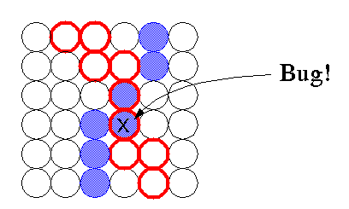
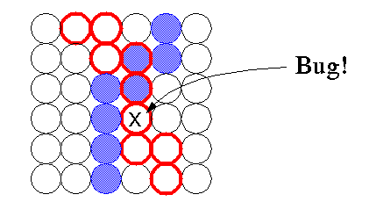
One Failed and One Successful Test (1)
Possible locations of faults
Code in the execution dice
A bug is in the failed execution slice (the red path) but not in the successful execution slice (the blue path)
Code in the failed execution slice but not in the dice
A bug is in the failed execution slice (the red path)
and in the successful execution slice (the blue path)
The dice-based technique can be effective in locating some program bugs
A Survey of Software Fault Localization Trinh Van Giang

Slide 15
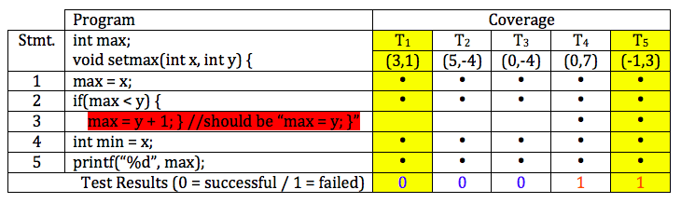
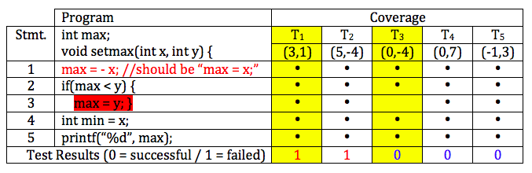
One Failed and One Successful Test (2)
Dice
Dice
A Survey of Software Fault Localization Trinh Van Giang

Slide 16
Multiple Failed and Successful Tests
intersection of failed tests – union of successful tests
union of failed tests – union of successful tests
intersection of failed tests – intersection of successful tests
union of failed tests – intersection of successful tests
Wong, W. Eric, et al. "Smart debugging software architectural design in SDL." Journal of Systems and Software 76.1 (2005): 15-28.
A Survey of Software Fault Localization Trinh Van Giang

Slide 17
Outline
Introduction
Execution Dice-based Fault Localization
Suspiciousness Ranking-based Fault Localization
  Program Spectrum-based Fault Localization
  Slicing Spectrum-based Fault Localization
  Similarity Coefficient-based Fault Localization
  Mutation-based Fault Localization
Important Issues and Research Areas
Conclusions
A survey of Software Fault Localization Trinh Van Giang

Slide 18
  Suspiciousness Ranking-based
  Fault Localization

Slide 19
Overview
Compute the suspiciousness (likelihood of containing bug) of each statement
Rank all the executable statements in descending order of their suspiciousness
Examine the statements one-by-one from the top of the ranking until the first faulty statement is located
Statements with higher suspiciousness should be examined before statements with lower suspiciousness as the former are more likely to contain bugs than the latter
A Survey of Software Fault Localization Trinh Van Giang

Slide 20
Techniques for Computing Suspiciousness
Take advantage of code coverage (namely, execution slice) and execution result of each test (success or failure) for debugging.
A Survey of Software Fault Localization Trinh Van Giang

Slide 21
Different Techniques
Program Spectrum-based Fault Localization
Slicing Spectrum-based Fault Localization
Similarity Coefficient-based Fault Localization
Mutation-based Fault Localization
A Survey of Software Fault Localization Trinh Van Giang

Slide 22
Outline
Introduction
Execution Dice-based Fault Localization
Suspiciousness Ranking-based Fault Localization
  Program Spectrum-based Fault Localization
  Slicing Spectrum-based Fault Localization
  Similarity Coefficient-based Fault Localization
  Mutation-based Fault Localization
Important Issues and Research Areas
Conclusions
A survey of Software Fault Localization Trinh Van Giang

Slide 23
  Program Spectrum-based Fault Localization

Slide 24
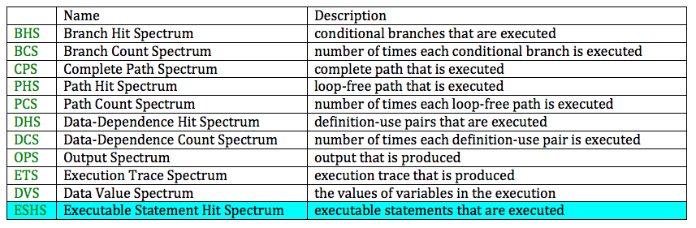
Spectrum-based Fault Localization Techniques
Possible Program Spectrum
A Survey of Software Fault Localization Trinh Van Giang

Slide 25
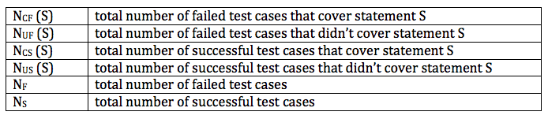
Executable Statement Hit Spectrum
ESHS records the executable statements that are covered by the test execution
Coverage information
A Survey of Software Fault Localization Trinh Van Giang

Slide 26
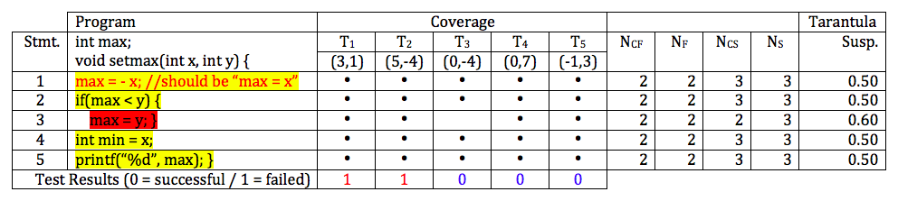
Tarantula
J. A. Jones and M. J. Harrold, “Empirical evaluation of the Tarantula automatic fault-localization technique,” in Proc. of the 20th IEEE/ACM Conference on Automated Software Engineering, pp. 273-282, Long Beach, California, USA, December, 2005
X/(X+Y), X=(N_{CF}/N_{F}) & Y=(N_{CS}/N_{S})
Tied Together
A Survey of Software Fault Localization Trinh Van Giang

Slide 27
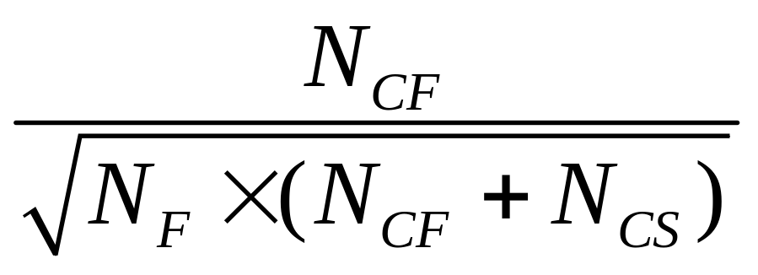
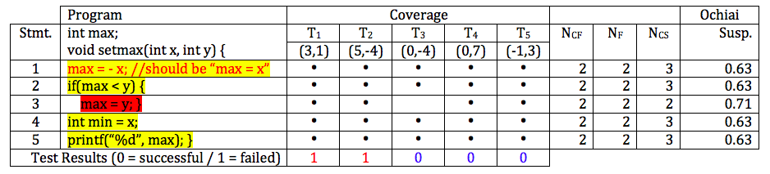
Ochiai
R. Abreu, P. Zoeteweij, R. Golsteijn, and A.J.C. van Gemund, “A Practical Evaluation of Spectrum-based Fault Localization,” Journal of Systems and Software, 82(11):1780 - 1792, 2009
A Survey of Software Fault Localization Trinh Van Giang

Slide 28
Outline
Introduction
Execution Dice-based Fault Localization
Suspiciousness Ranking-based Fault Localization
  Program Spectrum-based Fault Localization
  Slicing Spectrum-based Fault Localization
  Similarity Coefficient-based Fault Localization
  Mutation-based Fault Localization
Important Issues and Research Areas
Conclusions
A survey of Software Fault Localization Trinh Van Giang

Slide 29
  Slicing Spectrum-based Fault Localization

Slide 30
Slicing SBFL Technique
Slicing SBFL [Long H. PHAM, 2014] combine dynamic relevant slicing with spectrum-based fault localization
Firstly, the execution paths are sliced to filter out irrelevant statements
After that, N_{CS}(e) and N_{CF}(e) are calculated as the number of successful/failed test cases that have statement e in sliced execution paths
Long H. PHAM, Giang V. TRINH, Mai H. DINH, Nam P. MAI, Tho T. QUAN and Hung Q. NGO (2014), Assisting Students in Finding Bugs and Their Locations in Programming Solutions, In International Journal of Quality Assurance in Engineering and Technology Education (IJQAETE), IGI Global
A Survey of Software Fault Localization Trinh Van Giang

Slide 31
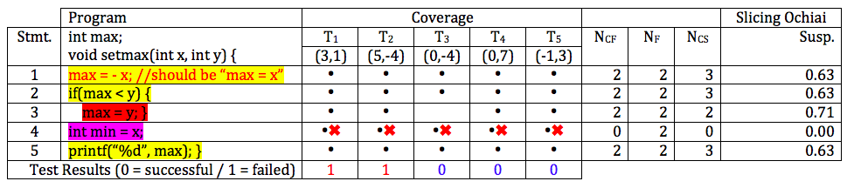
Slicing SBFL Example
A Survey of Software Fault Localization Trinh Van Giang

Slide 32
Outline
Introduction
Execution Dice-based Fault Localization
Suspiciousness Ranking-based Fault Localization
  Program Spectrum-based Fault Localization
  Slicing Spectrum-based Fault Localization
  Similarity Coefficient-based Fault Localization
  Mutation-based Fault Localization
Important Issues and Research Areas
Conclusions
A survey of Software Fault Localization Trinh Van Giang

Slide 33
  DStar − A Similarity Coefficient-based
  Fault Localization

Slide 34
The Construction of D* (1)
The suspiciousness assigned to a statement should be
Intuition 1: directly proportional to the number of failed test cases that cover it suspiciousness(s) α N_{CF}
Intuition 2: inversely proportional to the number of successful test cases that cover it suspiciousness(s) α 1/N_{CS}
Intuition 3: inversely proportional to the number of failed test cases that do not cover it suspiciousness(s) α 1/N_{UF}
Conveniently enough such a coefficient already exists
Kulczynski [Kulczynski, 1928]: N_{CF} /(N_{CS}+N_{UF})
Die pflanzenassoziationen der pieninen. Imprimerie de l'Université, 1928.
A Survey of Software Fault Localization Trinh Van Giang

Slide 35
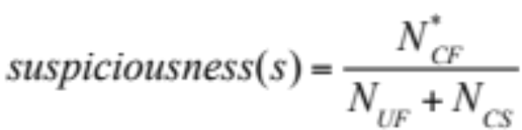
The Construction of D* (2)
Intuition 4: Intuition 1 is the most sound of the other intuitions and should therefore carry a higher weight.
Kulczynski does not lead to the realization of the fourth intuition.
A different coefficient (D* [Wong, W. Eric, et al])
Wong, W. Eric, et al. "Software fault localization using DStar (D*)." Software Security and Reliability (SERE), 2012 IEEE Sixth International Conference on. IEEE, 2012.
A Survey of Software Fault Localization Trinh Van Giang

Slide 36
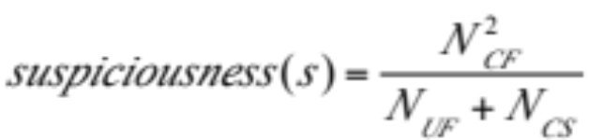
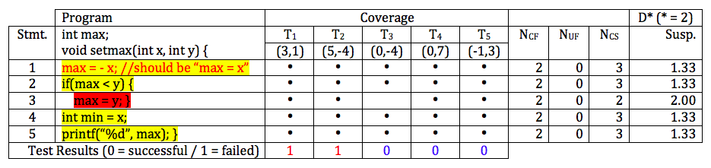
D* Example (with * = 2)
A Survey of Software Fault Localization Trinh Van Giang

Slide 37
  Empirical Evaluation

Slide 38
Observation
D* is evaluated across 24 programs and is compared to 38 different fault localization techniques.
Both single-fault and multi-fault programs are used.
Results indicate that D* is more effective at locating faults than all the other techniques it is compared to.
An empirical evaluation is also conducted to illustrate how
the effectiveness of D* increases as * grows, and then levels off
when * exceeds a critical value.
A Survey of Software Fault Localization Trinh Van Giang

Slide 39
Evaluation Metric
Total number of statements examined
  An absolute measure
The EXAM score: the percentage of code examined
  A relative measure
A Survey of Software Fault Localization Trinh Van Giang

Slide 40
Ties in the Ranking: Best/Worst
The suspiciousness assigned to a statement by D* (and other techniques) may not be unique, i.e., two or more statements can be tied for the same position in the ranking.
Assuming a faulty statement and some correct statements are tied
  In the best case we examine the faulty statement first
  In the worst case we examine it last
A Survey of Software Fault Localization Trinh Van Giang

Slide 41
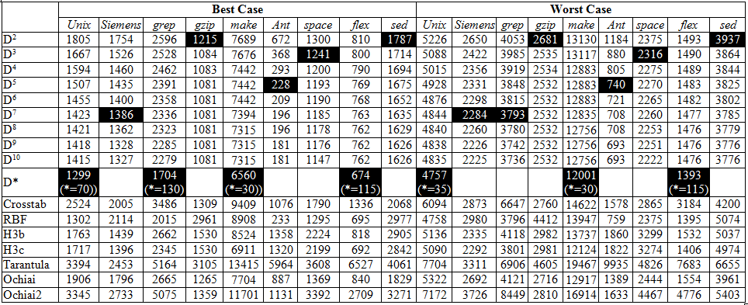
Results – Total Number of Statements Examined
A Survey of Software Fault Localization Trinh Van Giang

Slide 42
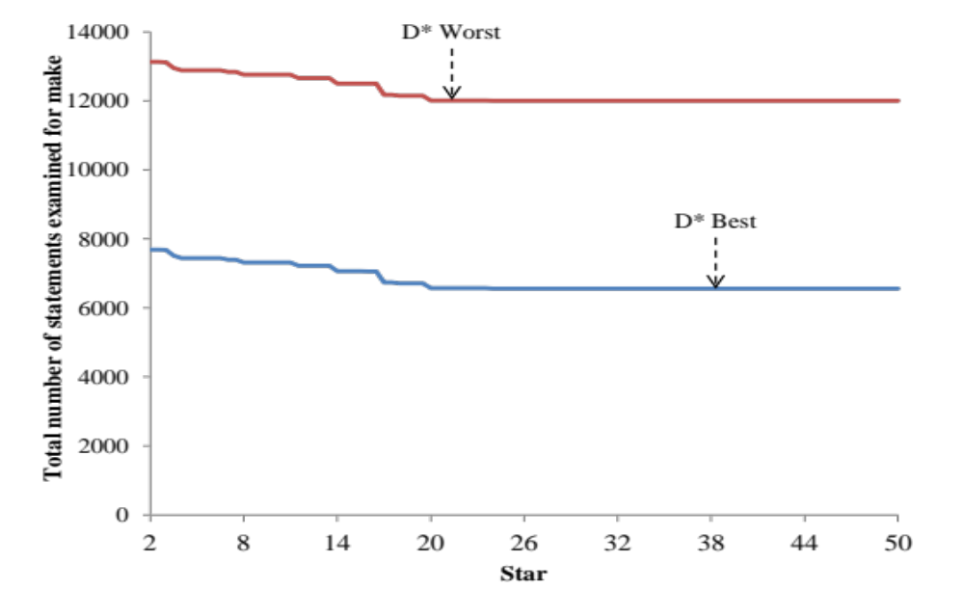
Effectiveness of D*
The effectiveness of D* for the make program increases until it levels off as the value of * increases.
A similar observation also applies to other programs.
A Survey of Software Fault Localization Trinh Van Giang

Slide 43
Outline
Introduction
Execution Dice-based Fault Localization
Suspiciousness Ranking-based Fault Localization
  Program Spectrum-based Fault Localization
  Slicing Spectrum-based Fault Localization
  Similarity Coefficient-based Fault Localization
  Mutation-based Fault Localization
Important Issues and Research Areas
Conclusions
A survey of Software Fault Localization Trinh Van Giang

Slide 44
  Mutation-based Fault Localization

Slide 45
MUSE Technique
Focus on syntactic mutant
  m_{f} be a mutant of P that mutates the faulty statement
  m_{c} be a mutant of P that mutates the correct statement
MUSE [Moon, Seokhyeon, et al] depends on the following two conjectures
Conjecture 1: test cases that used to fail on P are more likely to pass on m_{f} than on m_{c}
Conjecture 2: test cases that used to pass on P are more likely to fail on m_{c} than on m_{f}
Moon, Seokhyeon, et al. "Ask the Mutants: Mutating Faulty Programs for Fault Localization." Software Testing, Verification and Validation (ICST), 2014 IEEE Seventh International Conference on. IEEE, 2014.
A Survey of Software Fault Localization Trinh Van Giang

Slide 46
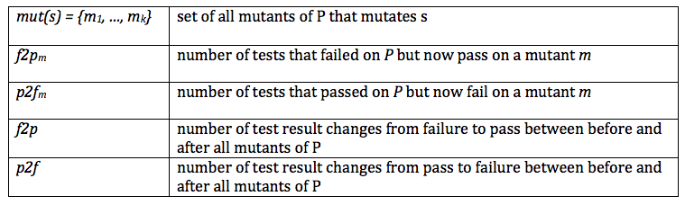

Suspiciousness Metric of MUSE
A Survey of Software Fault Localization Trinh Van Giang

Slide 47
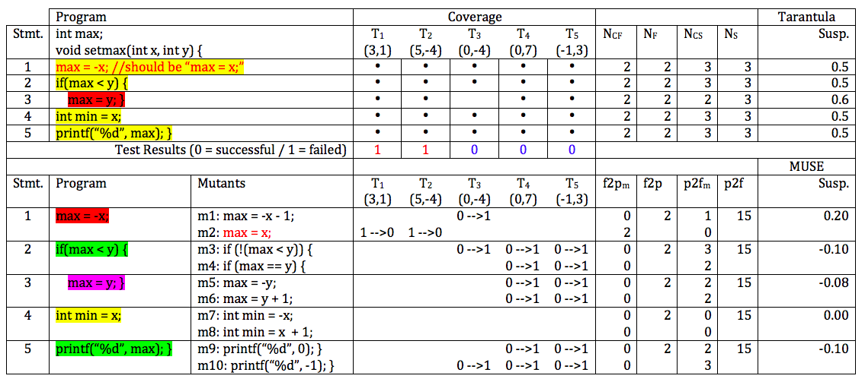
MUSE Example (1)
A Survey of Software Fault Localization Trinh Van Giang

Slide 48
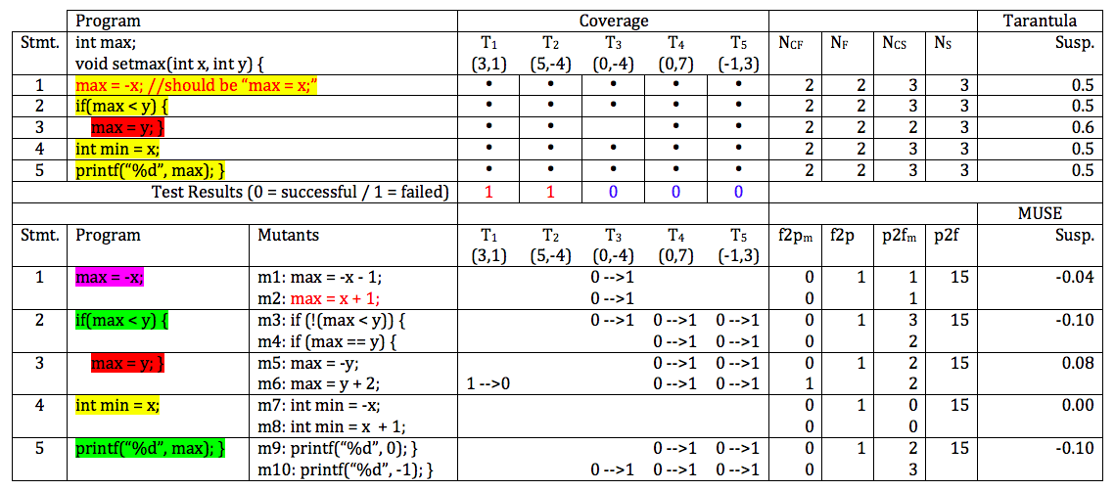
MUSE Example (2)
A Survey of Software Fault Localization Trinh Van Giang

Slide 49
Outline
Introduction
Execution Dice-based Fault Localization
Suspiciousness Ranking-based Fault Localization
  Program Spectrum-based Fault Localization
  Slicing Spectrum-based Fault Localization
  Similarity Coefficient-based Fault Localization
  Mutation-based Fault Localization
Important Issues and Research Areas
Conclusions
A survey of Software Fault Localization Trinh Van Giang

Slide 50
  Effectiveness of A Fault Localization
  Technique

Slide 51
Effectiveness
The effectiveness of a fault localization technique inversely proportional number of statements examined
Minimize number of statements examined
Tied together: different statements may be assigned the same suspiciousness by a fault localization method
Tied-breaking
A Survey of Software Fault Localization Trinh Van Giang

Slide 52
  Faults Introduced by Missing Code

Slide 53
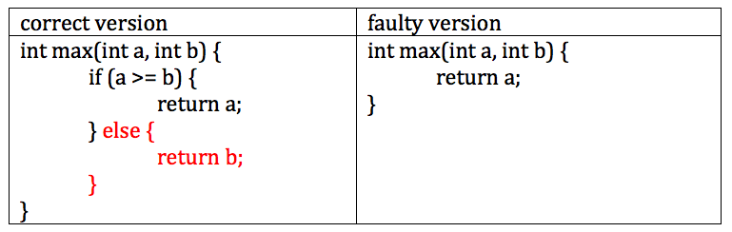
Missing Code Problem
A Survey of Software Fault Localization Trinh Van Giang

Slide 54
Outline
Introduction
Execution Dice-based Fault Localization
Suspiciousness Ranking-based Fault Localization
  Program Spectrum-based Fault Localization
  Slicing Spectrum-based Fault Localization
  Similarity Coefficient-based Fault Localization
  Mutation-based Fault Localization
Important Issues and Research Areas
Conclusions
A survey of Software Fault Localization Trinh Van Giang

Slide 55
  Conclusion

Slide 56
Conclusion
Even with the presence of so many different fault localization techniques, fault localization is far from perfect
While these methods are constantly advancing, software too is becoming increasingly more complex
challenges posed by fault localization are also growing
A Survey of Software Fault Localization Trinh Van Giang

Slide 57
  Questions ?

